Slide 1

[Aggregate Anseong Plant] Electric Shock RCA Report
- Table of Contents -
I. RCA Attendees
II. Accident Summary
III. Root Cause Analysis (RCA)
IV. Recurrence Prevention Measures
2024.10.02
Anseong Plant

Slide 2
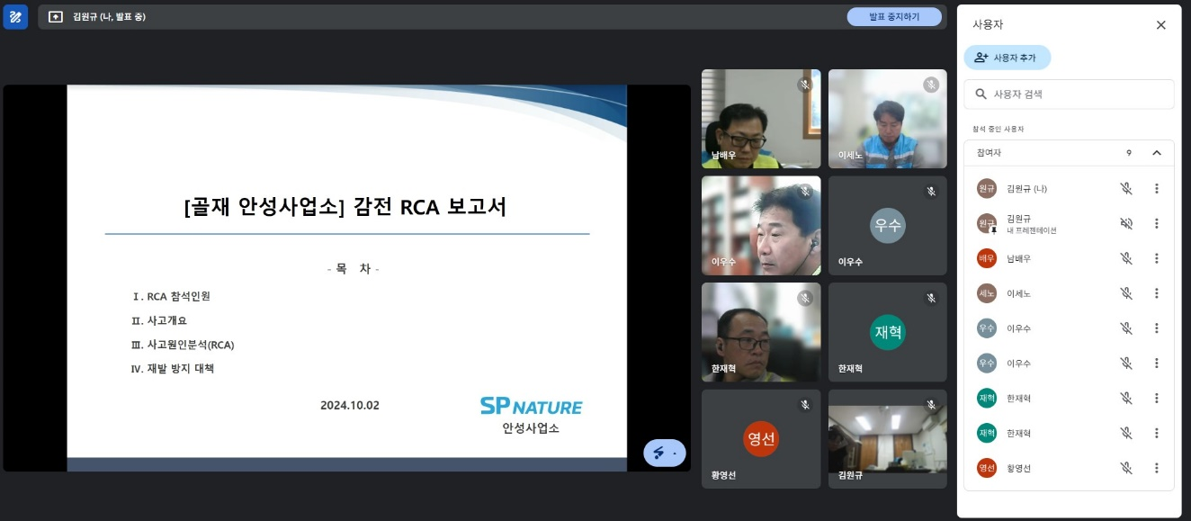
Ⅰ. RCA Attendees
RCA(Root Cause Analysis)
No | Name | Company / Affiliation | Position
1 | Gochang-su | SP Nature Co., Ltd. / Environment & Safety | CSO
2 | Yu Min-chul | SP Nature Co., Ltd. / Construction Materials Safety Part | Safety Part
3 | Kim Ho-gyeom | SP Nature Co., Ltd. / Construction Materials Safety Part | Safety Part
4 | Kim Jun-hee | SP Nature Co., Ltd. / Anseong Plant | Production Team Leader
5 | Kim Won-gyu | SP Nature Co., Ltd. / Anseong Plant | Safety Officer
6 | Lee Se-no | SP Nature Co., Ltd. / Yesan Plant | Plant Manager
7 | Lee Woo-su | SP Nature Co., Ltd. / Yesan Plant | Safety Officer
8 | Han Jae-hyeok | SP Nature Co., Ltd. / Yesan Plant | Production Team Leader
No | Name | Company / Affiliation | Position
9 | Nam Bae-woo | Hongmyeong Industry Co., Ltd. | Plant Manager
10 | Hwang Young-seon | Hongmyeong Industry Co., Ltd. | Safety Officer
11
12
13
14
15
16
Meeting Photo

Slide 3
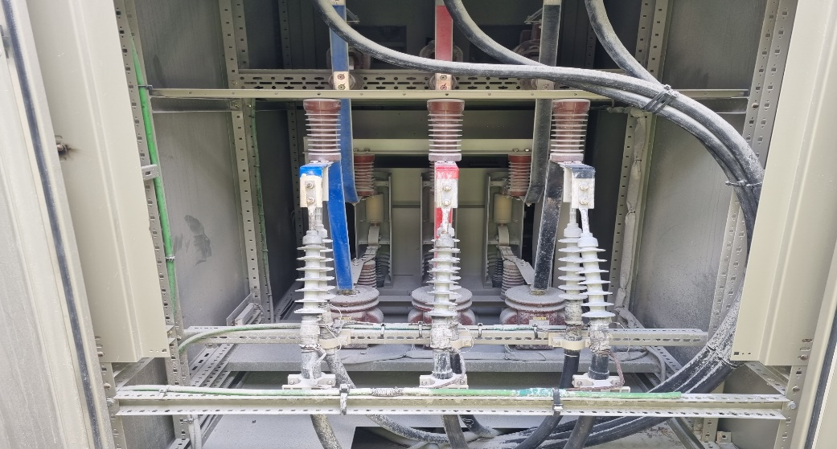
II. Accident overview
RCA (Root Cause Analysis)
Aggregate Anseong Plant electrocution accident
Disaster occurrence status
1. Date / Location | Fri., 2024.09.27, around 10:45 AM / Panel room
2. Injured person / Affiliation | Manager Eun-taek Kim / Anseong Plant Production Team | 3. Gender / Age | Male / 30 years old
4. Accident type | Electrocution | 5. Degree of damage | Burns (under hospital treatment)
□ Accident details ∙ On Friday, Sept. 27, 2024, at approximately 10:45 AM, Manager Eun-taek Kim of the Anseong Plant Production Team opened a panel in the on-site substation room to check whether corrective actions were taken for deficiencies found during equipment inspections conducted in August (dust accumulation inside the VCB panel). While blowing air into the panel to remove the dust inside, he was electrocuted. ※ Treated for burns at Osong Vestian Hospital and currently hospitalized at Yeongdeungpo Hangang Sacred Heart Hospital □ Causes of the accident ∙ Failure to follow substation room entry procedures (insufficient control by electrical safety manager) ∙ LOTOTO not performed (power not shut off) / shared key management (Production Team) ∙ Safety permit for work not completed / two-person inspection not performed ∙ Insulating protective gear not worn □ Recurrence prevention measures ∙ Strengthen substation room entry procedures (One key management / maintain entry log) ∙ Implement LOTOTO (power shutoff, control box: ASS Controller) ∙ Prepare safety work permits / conduct two-person inspections ∙ Wear insulating protective gear
Disaster situation map (photo)

